Slide 1

DATA LINK LAYER
Data Link Layer
The data link layer is located between the network layer and the physical layer and provides services for protocols such as IP and IPv6 at the network layer. PDUs transmitted at the data link layer are called frames.
Ethernet is the most common data link layer protocol.
The data link layer is located between the network layer and the physical layer.
The data link layer provides intra-segment communication for the network layer.
The functions of the data link layer include framing, physical addressing, and error control.
Common data link layer protocols include Ethernet, PPPoE, and PPP.
OSI MAPING
Standard TCP/IP model
OSI model
Equivalent TCP/IP model

Slide 2
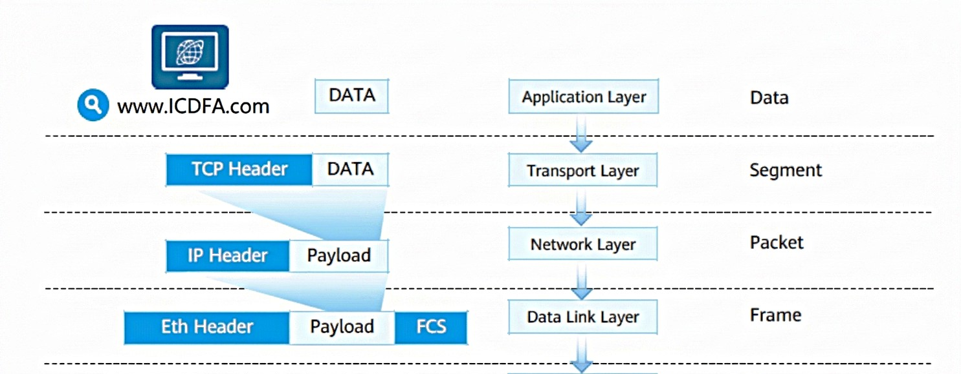
DATA ENCAPSULATION AT THE SENDER
A Media Access Control (MAC) address uniquely identifies a Network Interface Card (NIC) on a network. Each NIC requires and has a unique MAC address.
MAC addresses are used to locate specific physical devices in an IP network segment.
A device that works at the data link layer, such as an Ethernet switch, maintains a MAC address table to guide data frame forwarding.

Slide 3
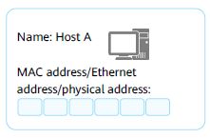
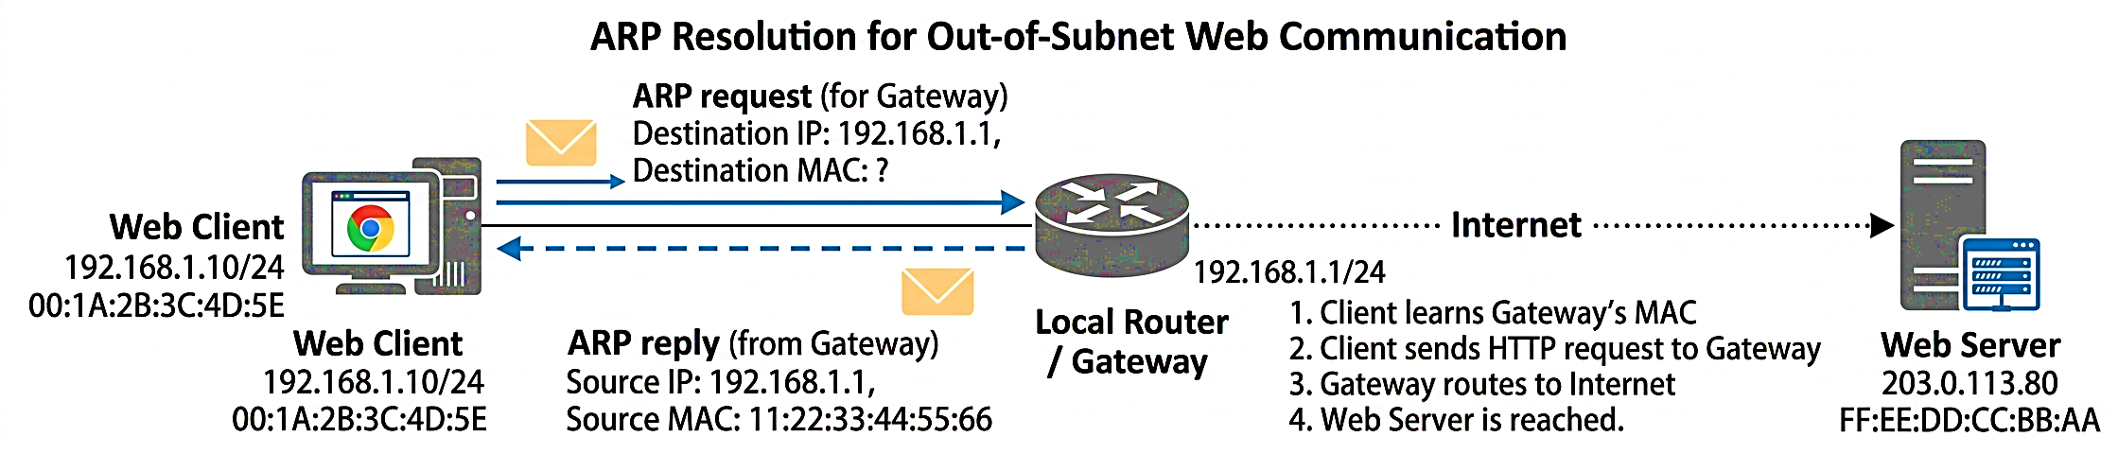
A MAC address is recognizable as six groups of two hexadecimal digits, separated by hyphens, colons, or written without a separator.
Example: 48-A4-72-1C-8F-4F
ARP
Address Resolution Protocol (ARP):
  Discovers the MAC address associated with a given IP address.

